Slide 1
RIGA TECHNICAL UNIVERSITY
Kick off Meeting « International cooperation for rational Use of Raw Materials and Circular Economy»
Kick off Meeting,Wroclaw,13 -15/03/2019

Slide 2

RTU - Latvian Centre of Engineering Science
Established in 1862
Oldest technical university in the Baltic states
9 faculties, 140 study programs
4 affiliations- Cēsis,Liepāja,Ventspils,Daugavpils
+ Rigas Business School, Engineering High School
BALTECH (consortium of seven engineering universities from Baltic Sea Region)

Slide 3
9 faculties
Faculty of Architecture
Faculty of Civil Engineering
Faculty of Computer Science and Information Technology
Faculty of E-Learning Technologies and Humanities
Faculty of Electronics and Telecommunications
Faculty of Power and Electrical Engineering
Faculty of Engineering Economics and Management
Faculty of Mechanical Engineering, Transport and Aeronautics
Faculty of Materials Science and Applied Chemistry

Slide 4
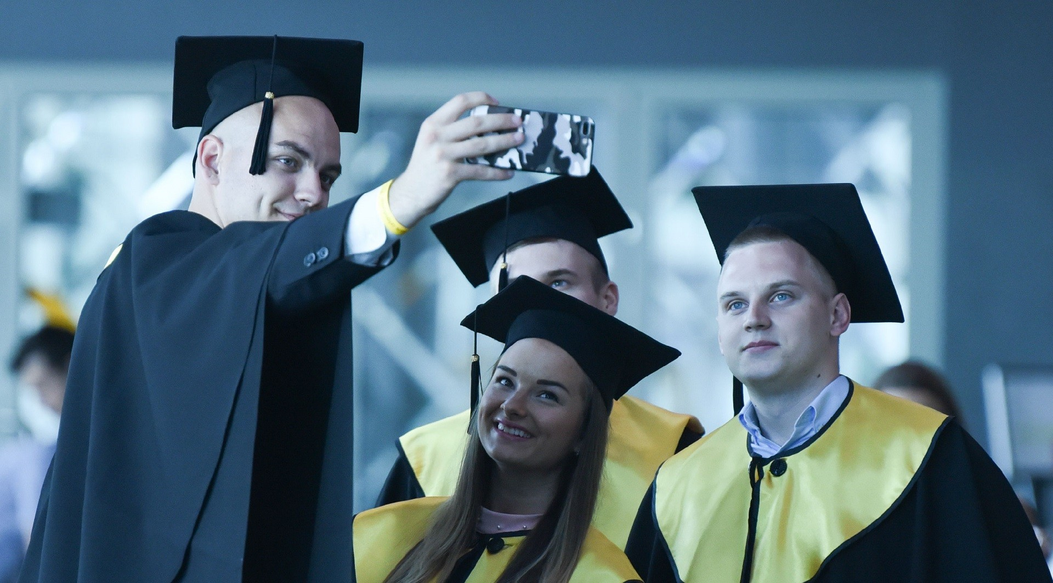
Facts & Figures and research
capacity in related areas
≥ 40% of national funding fromindustry
Only in Baltics having contact with CERN
Most of science – based startups
Latvian material science is one of leading in region (itation/scientist)
On going Excellence centre projects
( 1phase passed)
RTU graduates at grand graduation
Research staff
Leading Researchers | 225
Researchers | 289
Scientific Assistants | 170
Total | 684
Laboratories | 21
Institutes | 35
Publications (Scopus) | 1200
Citations (Scopus) | 885

Slide 5
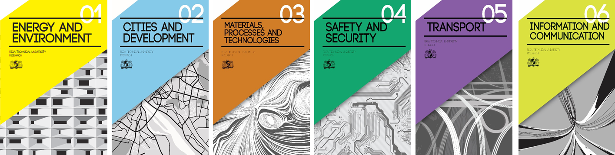
Research platforms
Research at RTU is organized on six research platforms.
The objective of research platforms is to ensure multi-faculty and interdisciplinary research in the areas of great significance for the national economy and society.
Active and continuous analysis of market needs and commercial potential takes place within the research platforms.

Slide 6
Research directions of the platform
«Energy and Environment» at RTU
*Safety of power supply systems and optimum operational modes for the improvement of performance
and economic return
*Methods and technologies for the improvement of power and thermal energy generation, transmission,
distribution and consumption efficiency
*Methods and technologies for the promotion of renewables to increase the regional energy independence and reduce environmental impact
*Climate technologies and environmental methods for circular economy

Slide 7
Environmental methods for circular economy from RTU perspective
To convert waste materials in valuably materials and products
To use less toxic,less critical raw materials
To elaborate the methods and technologies for the reducing water pollution including biogenic elements
*‘’Closing the loop’’ of product life cycles
*Benefits for environment and economy
*Turning industry’s by- product into another industry’ s raw material
*Sustainable sourcing of raw materials
*Boosting the market for secondary raw materials
*Encourage recovery of critical raw materials
Easy to recycle design
*based on EU Commision’s statement

Slide 8
Valorisation
Innovation and Technology Transfer Centre - promoting recognition of intellectual potential and innovation and technology transfer
Research Infrastructure and Technology Support Centre- provides access to RTU research infrastructure and resources
Design Factory offers support in the fields of research, design, prototyping and education
Department of Business Development and Investments- establish and sustain long-term relationships with business and social partners, increase the number of contracts and attract investments
Business incubators: student business incubator in Cēsis, IdeaLab, and other.

Slide 9
Innovation and Technology Transfer Centre (ITTC)
The main purpose of the ITTC is to promote the development and growth of RTU in the field of innovation and technology transfer, as well as to enhance the recognition and competitiveness of intellectual potential, to encourage the formation of environment that is positive and open to new technologies
The main activities:
Iintellectual property protection and development
Tichnology transfer process assurance
Cooperation with Industry
Oorganization of seminars and visits
www.inovacijas.rtu.lv

Slide 10

IP portfolio
Patents 2018
National (Latvian) patents held | 94
National (Latvian) patent applications | 10
National (Latvian) patents granted | 18
European patents granted | 2
European Patents Maintained | 9
Licence Agreements | 6

Slide 11
















Cooperation with Industry
Contract research
Collaborative projects
Industrial design and prototyping
Technology licensing
Expertise
Test
Consultations

Slide 12

Technology Transfer Program
National program coordinated by LIAA
The objective of the program is to support the development of commercialisation competence of the research results in state research organisations
Funding – ERDF
Amount - 300 K Eur per tech transfer project
Feasibility study and commercialisation strategy
Research & development acitivities and commercialisation activities
Pitch before proposal application
3 years long period
Supported activities
Notes:
Technology transfer programme is national support programme for technology development and commercialisation.
Programme is designed and coordinated by Investment and development agency of Latvia (LIAA)
It is structured in two phases:
1st phase is feasibility study. During initial 6 month commercialisation project teams with business leaders carryies out a technical and economic feasibility study and develops commercialisation strategy.
Feasibility study is the initial design stage of any project, which brings together the elements of knowledge that indicate if a project is possible or not.

Slide 13
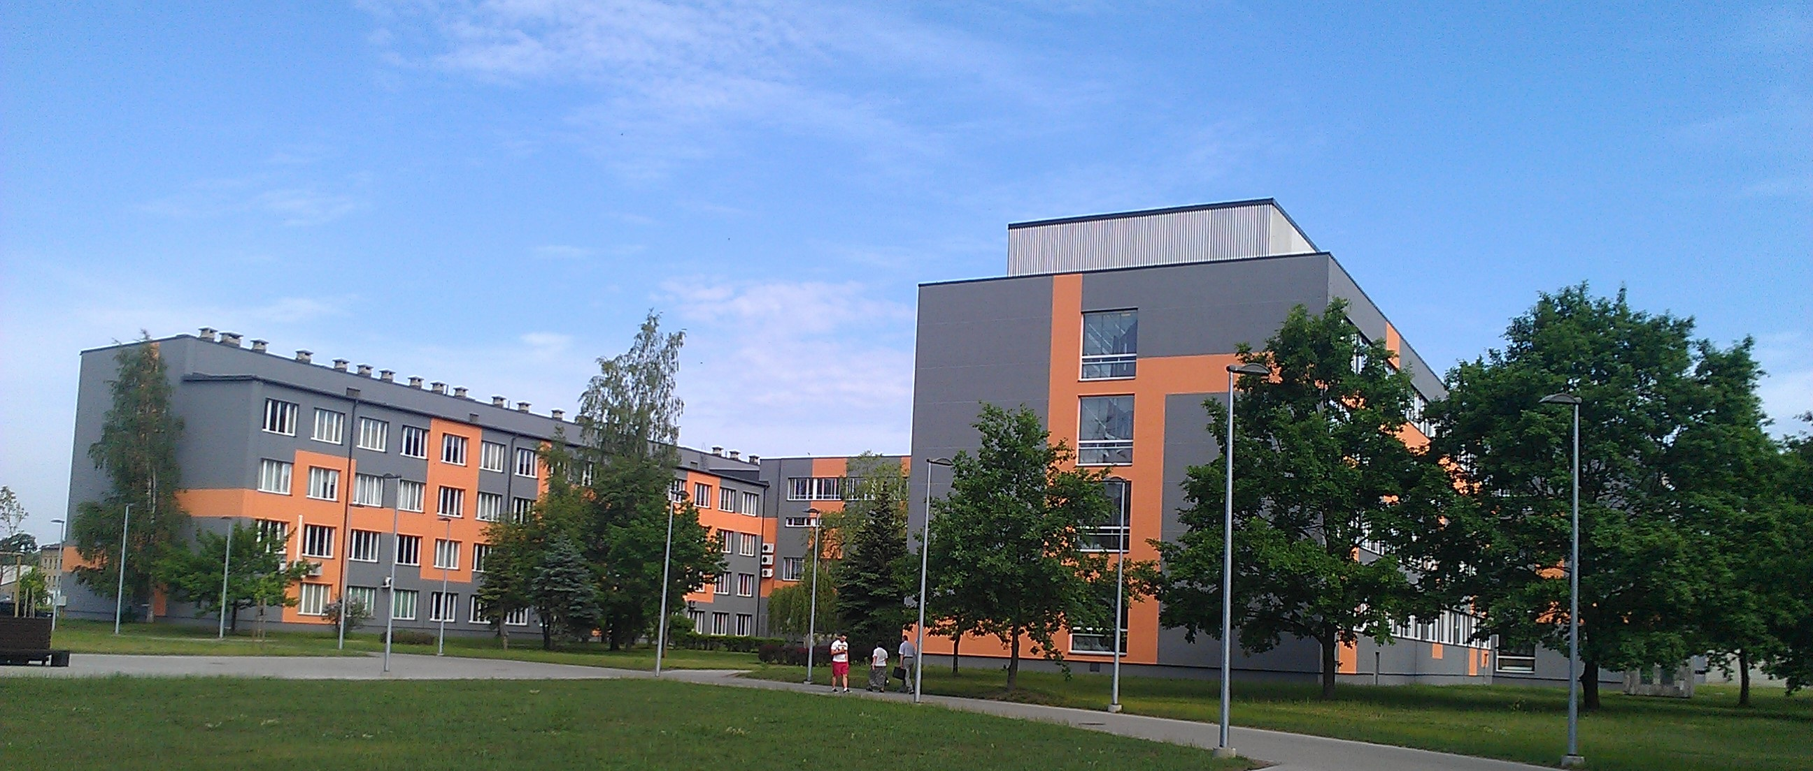
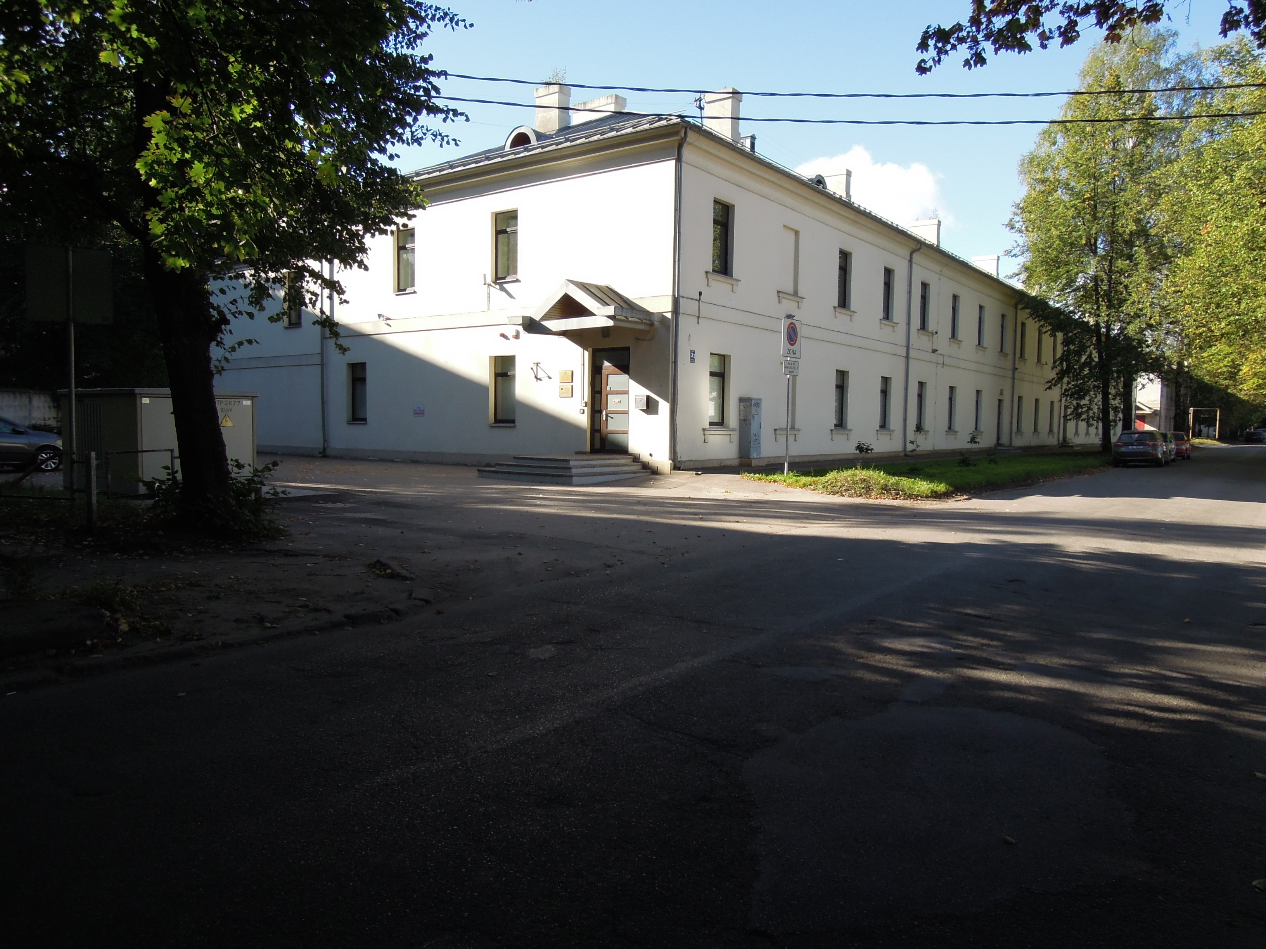
Faculty of Materials Science and Applied Chemistry
Institute of Applied chemistry (18)
Institute of Design Technologies (19)
Institute of General Chemical Engineering (3)
Institute of Polymer materials (9)
Institute of Silicate Materials (7)
Institute of Technical Physics (13)
Institute of Technology of Organic Chemistry (6)

Slide 14



02000-3.2.-e/3, 10/05/2018
01.01.2018.-30.03.2020.
On going project
Best Management Practices (BMPS) of sustainable Phosphorus (P) usage for closing the P cycle in Baltic countries (InPhos)

Slide 15
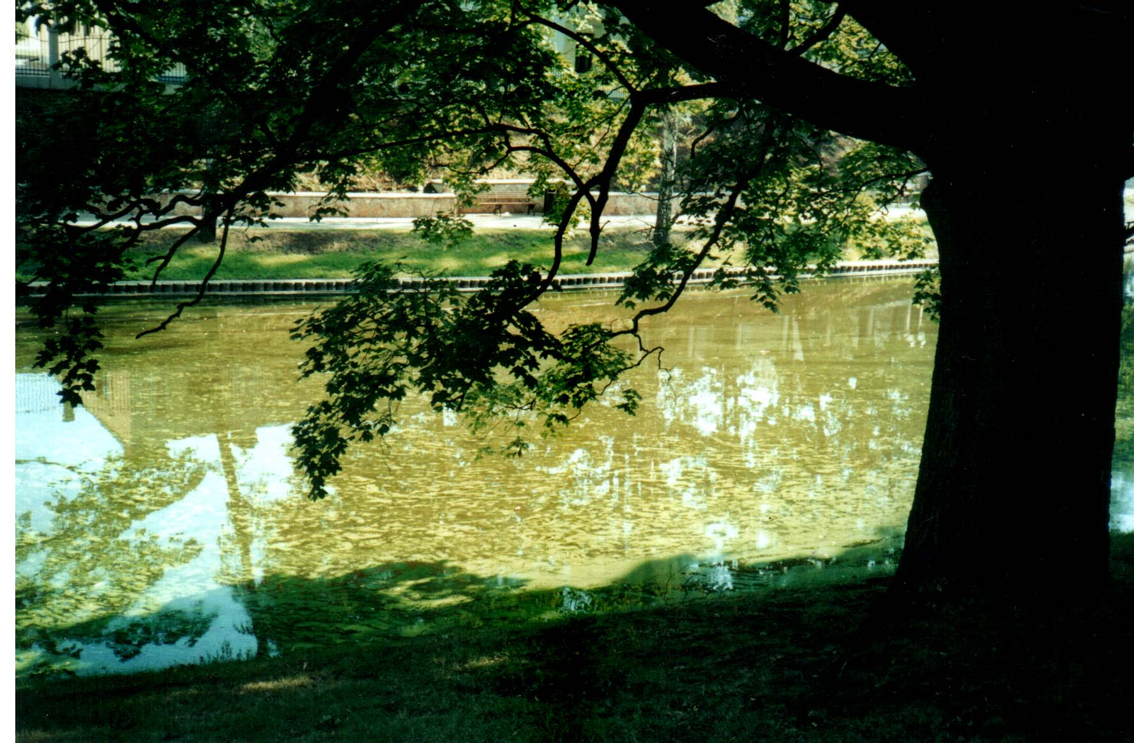
Phosphorous as a Critical Raw Material - Environmental Concerns
The environmental significance of phosphorus arises from its role as a major nutrient for both plants and microorganisms
Eutrophication. Riga City channel- 2011. Photo D.Kalnina
P-rich waste to the Baltic sea creates trans baundary threats, and in this situation the development of the sustainable P usage model must be trans-national.
The Baltic countries have joined forces in order to safeguard the Baltic P-syply chain and develop of sustainable P management strategy.
Notes:
The environmental significance of phosphorus arises from its role as a major nutrient for both plants and microorganisms. The limitation of these elements is usually the limiting factor of their growth. Algal blooms do not occur when either nitrogen or phosphorus are present in limited amounts, however, in changing environmental circumstances and with the presence of bacterial enzymes the phosphorus adsorbed by algae can be transferred to water. The result is often that the balance of production and consumption in the food chain is disturbed, which – in most cases – leads to algae becoming the dominant life form in water.

Slide 16
Strategic InPhos objectives :
identification of best management practices of sustainable phosphorus usage existing in developed countries,
identification of the recovery potential for phosphorus in the Baltic region,
transfer of knowledge and design of solutions for the sustainable use of phosphorus in the Baltic region,
promotion of the closing of the phosphorus cycle in the Baltic region,
building of a ‘phosphorus responsible society’,
educational development- improvement of the skill basis of the knowledge triangle in the Baltic region.

Slide 17
Wastewater as a phosphorus source

Slide 18
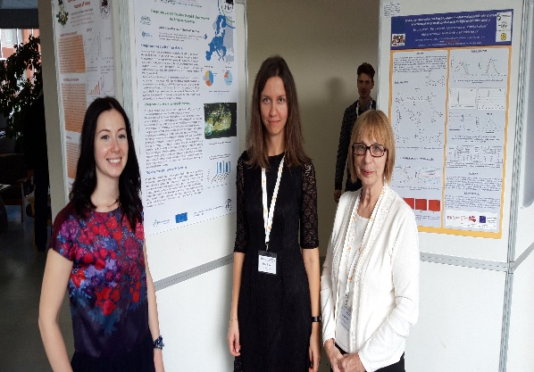
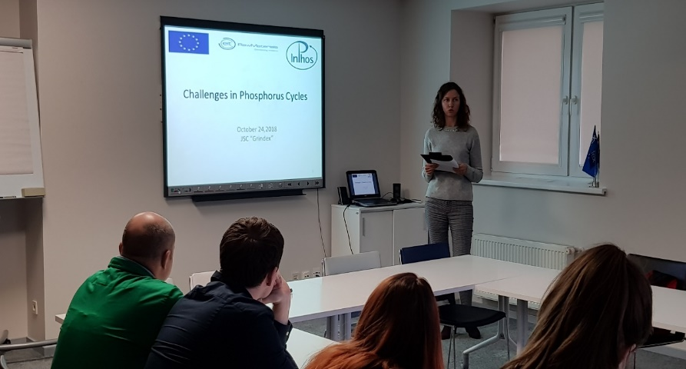
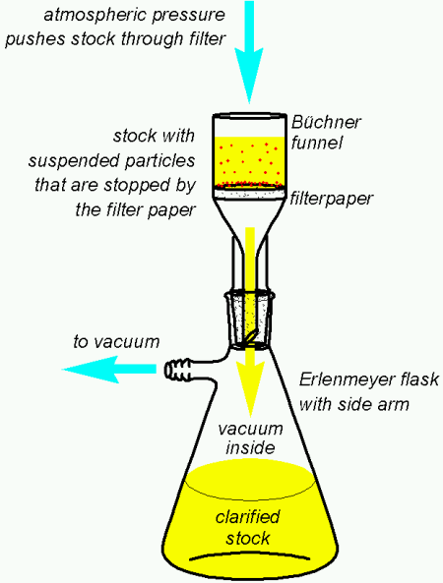
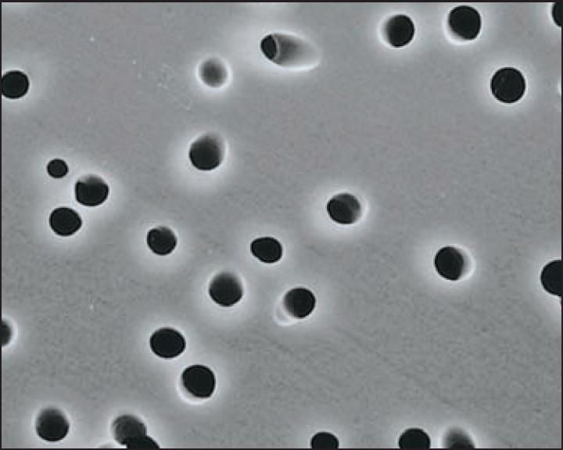
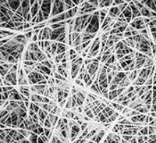
Dissemision activities
59 International conference (MSAIC) RTU, October 26, 2018
Education seminarJSC Grindex, October 24, 2028
Education tools – method validation document for phosphorous detection

Slide 19
On going project
Circular Economy Innovative Skills in the Textile sector (ECO TEX)
The project addresses a key issue such as sustainability in the textile sector,
requiring specialists in the sector to respond flexibly to market developments
the need for sustainable design and production to support global demand for sustainable creative products.
The main objective of THE ECO-TEX project is to develop a new qualification (profession) and an appropriate training programme on “How to implement circular economic methods in the textile industry” to improve competitiveness in the textile sector, based on the development of skills and competences of the workforce.
Partners Confederación de la Industria Textil - TEXFOR (Spānija)
Hellenic Fashion Industry Association - SEPEE (Grieķija)
Technical University of Iasi – TUIASI (Rumānija)
Rīgas Tehniskā Universitāte - RTU (Latvija)
Centro Tecnologico das Industrias textile e do Vestuario de Portugal –

Slide 20
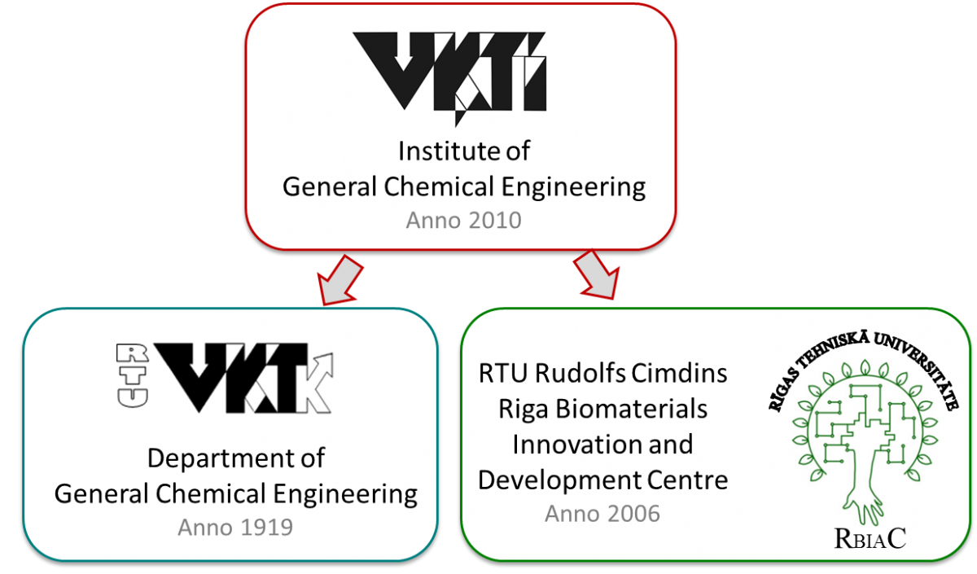
Faculty of Materials Science and Applied Chemistry
Institute of General Chemical Engineering

Slide 21
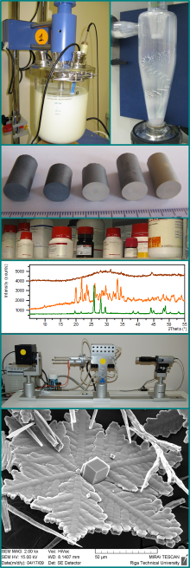
The research covering the specific scientific disciplines in the area of Institute of General Chemical Engineering
Biomaterials
Calcium phosphate ceramic materials for bone replacement
Microencapsulation of biologically active substances
Bimodal porous calcium phosphate bio ceramic scaffolds
Eco materials
Thermoelectric materials based on titanium dioxide
Electrochemical drinking water treatment technology
Properties of Latvian clays, including sorption
Sorption of various materials
Biotechnology:
Fermentation process research and modelling

Slide 22
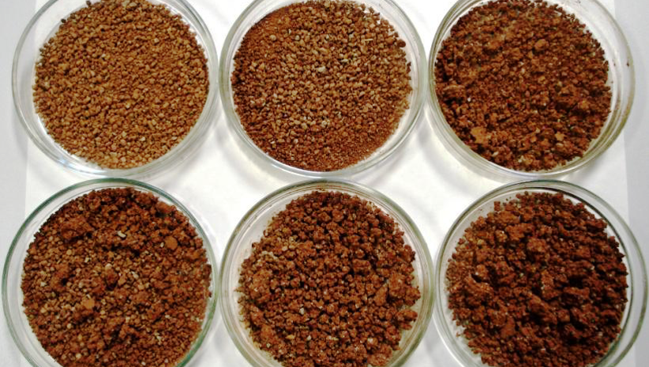
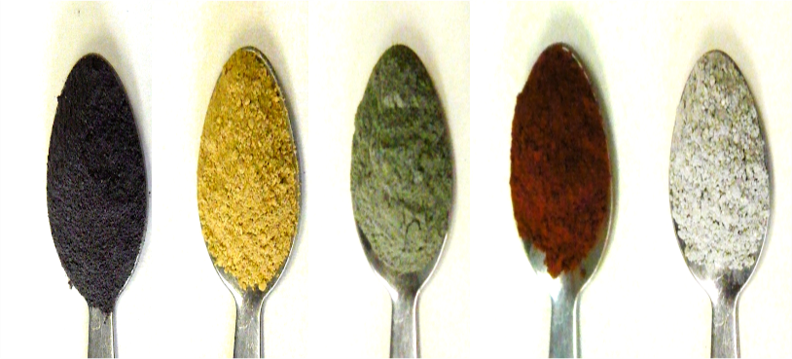
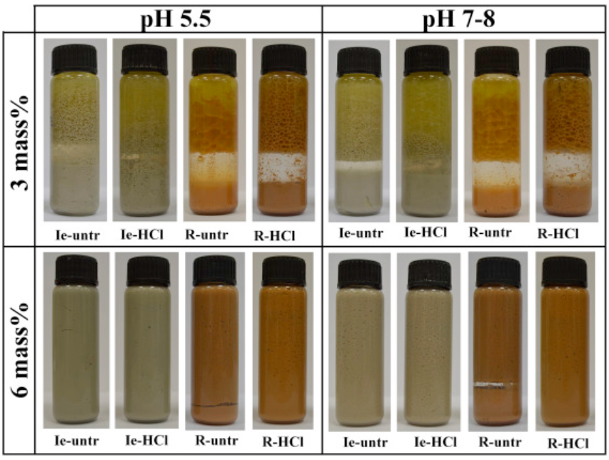
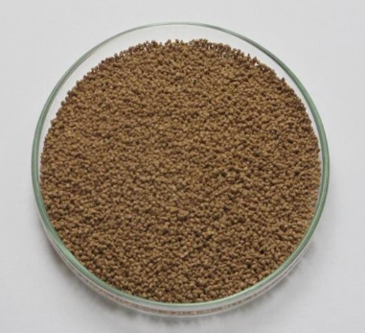
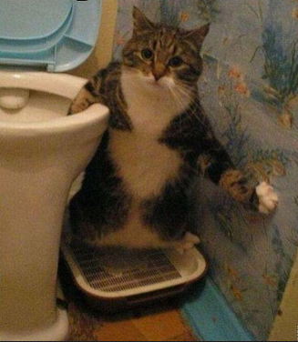
Rational use of Raw materials - Clays
Properties and applications of Latvian clays
Adsorbents for environmental remediation
Adsorbents for cosmetic purpose
Oil-in water emulsions at rest after 3 weeks with 3 mass% and 6 mass% containing two types of raw (Ie-untr and R-untr) and purified (Ie-HCl and R-HCl) clay at pH 5.5 and pH 7–8

Slide 23
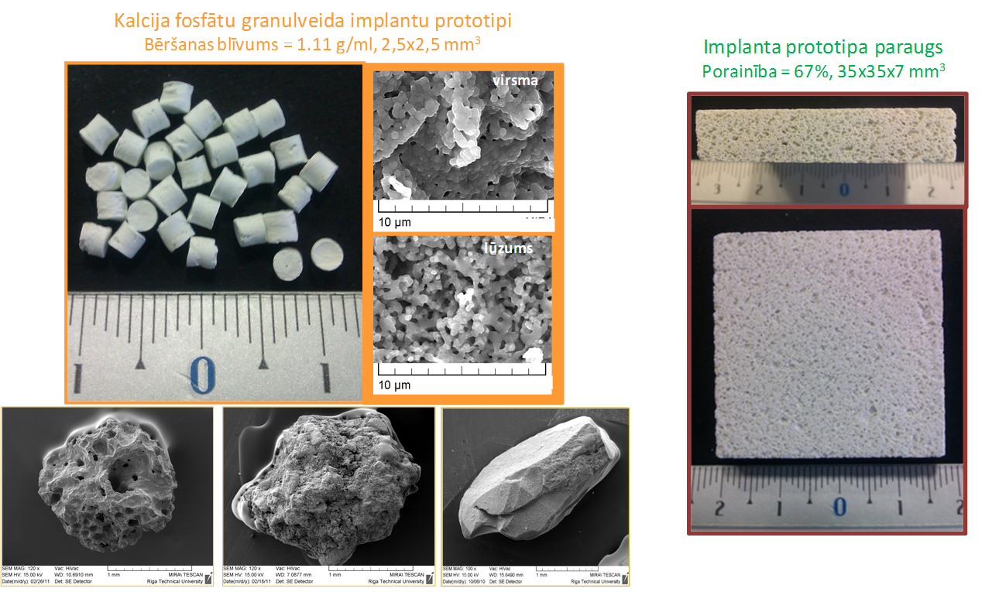
Calcium phosphates and their diversity
surface
β-TCP
1.50
Ca/P
HAp
1.67
ß-Ca₃(PO₄)₂
Ca₁₀(PO₄)₆(OH)₂
fracture
Modified large scale calcium phosphate (tricalcium phosphate (TCP) and hydroxyapatite (Hap) has been developed,
Synthesis methods permit to vary the parameters of the synthesis, controlling the Ca/P ratio
In the synthesized product and the Hap/TCP ratio in the sintered ceramics .
The product can be applied in different environmental clean-up activities.
Biotechnologies : purification and deposition of biotechnological products
Riga Technical University

Slide 24
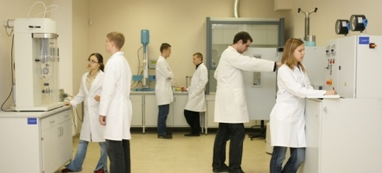
Equipment and knowledge
For determination of composition
Liquid chromatograph with UV,
Fluorescent and light scattering detectors
X-ray powder diffractometer,
Scanning electron microscope
FT-IR spectrometer
UV/VIS spectrometers
For particle size determination:
Laser granulometer
Vibrating sieve machine
Optical Microscopes
For liquid
Bioreactor
Centrifuges
Rotational viscometer
For pastes and powders
Extruder
Facility for determining the plasticity,
Moisture analyzer
High-temperature DTA/DSC,
Spray drying device
Gas adsorption – porosimetry

Slide 25
Circular economy /rational use of raw materials- a vision
Industries communication and colaboration with higher education institutions - a very necessary stage for sustainable use of raw materials and circular economy :
One of the solutions - jointly used open type technology transfer infrastructure (RAWMHUB ?) bringing together industry (companies, SMS, researchhers, academic personnel ) and allowing them to work on the development of new materials and their manufacturing procesess
The involvement of students in the performance of various levels of research adressing real problems related to rational use and recovery of raw materials , covering the requirements of different levels of qualifications (Bachelor, Masters and Doctoral )
Cooperation with producers with common challenges in the area of resource recover
(

Slide 26
Paldies !
Thank You For Attention!
Dr.chem. Daina Kalnina
Riga Technical University
Daina.Kalnina@rtu.lv
www.rtu.lv

